Slide 1

WEATHER DATA , MUSIC & MOVIE powered by ITUNE API/OPENWEATHER.ORG

Slide 2
Elevator Pitch
We provide user with essential and entertaining information in their daily life.
Users are informed of current time along with weather information.
Users have choice to select number of choices each music and movie .
User will receive number of music / movie information and then can select
to view video images.

Slide 3
Concept
DESCRIPTION:
User searches weather on user’s area , based on weather data of User’s area .. App suggest best music, movies info to users
MOTIVATION :
discover new music and movie to enhance users feeling.
USERSTORY :
As a user , I want to receive current weather with music/movies recommended to me based on current weather.

Slide 4
Technologies to use :
API:
Music/Movie:
https://affiliate.itunes.apple.com/resources/documentation/itunes-store-web-service-search-api/
Open weather :
https://openweathermap.org/api
CSS Framework:
Foundation
https://get.foundation/
Color:
https://material.io/resources/color/
https://cssgradient.io/
Fonts:
https://fonts.google.com/

Slide 5
Tasks & roles:
Front end part:
Michael Rosa-Vourazeris
Kristina al-ashqar
Back end part:
Olivia, Youngmee, Park
Paul Nuguyen
Our Challenges & Success:
Challenge : Cors Error, Github access
Success : able to accomplish the goal
Git hub page :
https://github.com/Oliviapark113/project7_group-1/

Slide 6
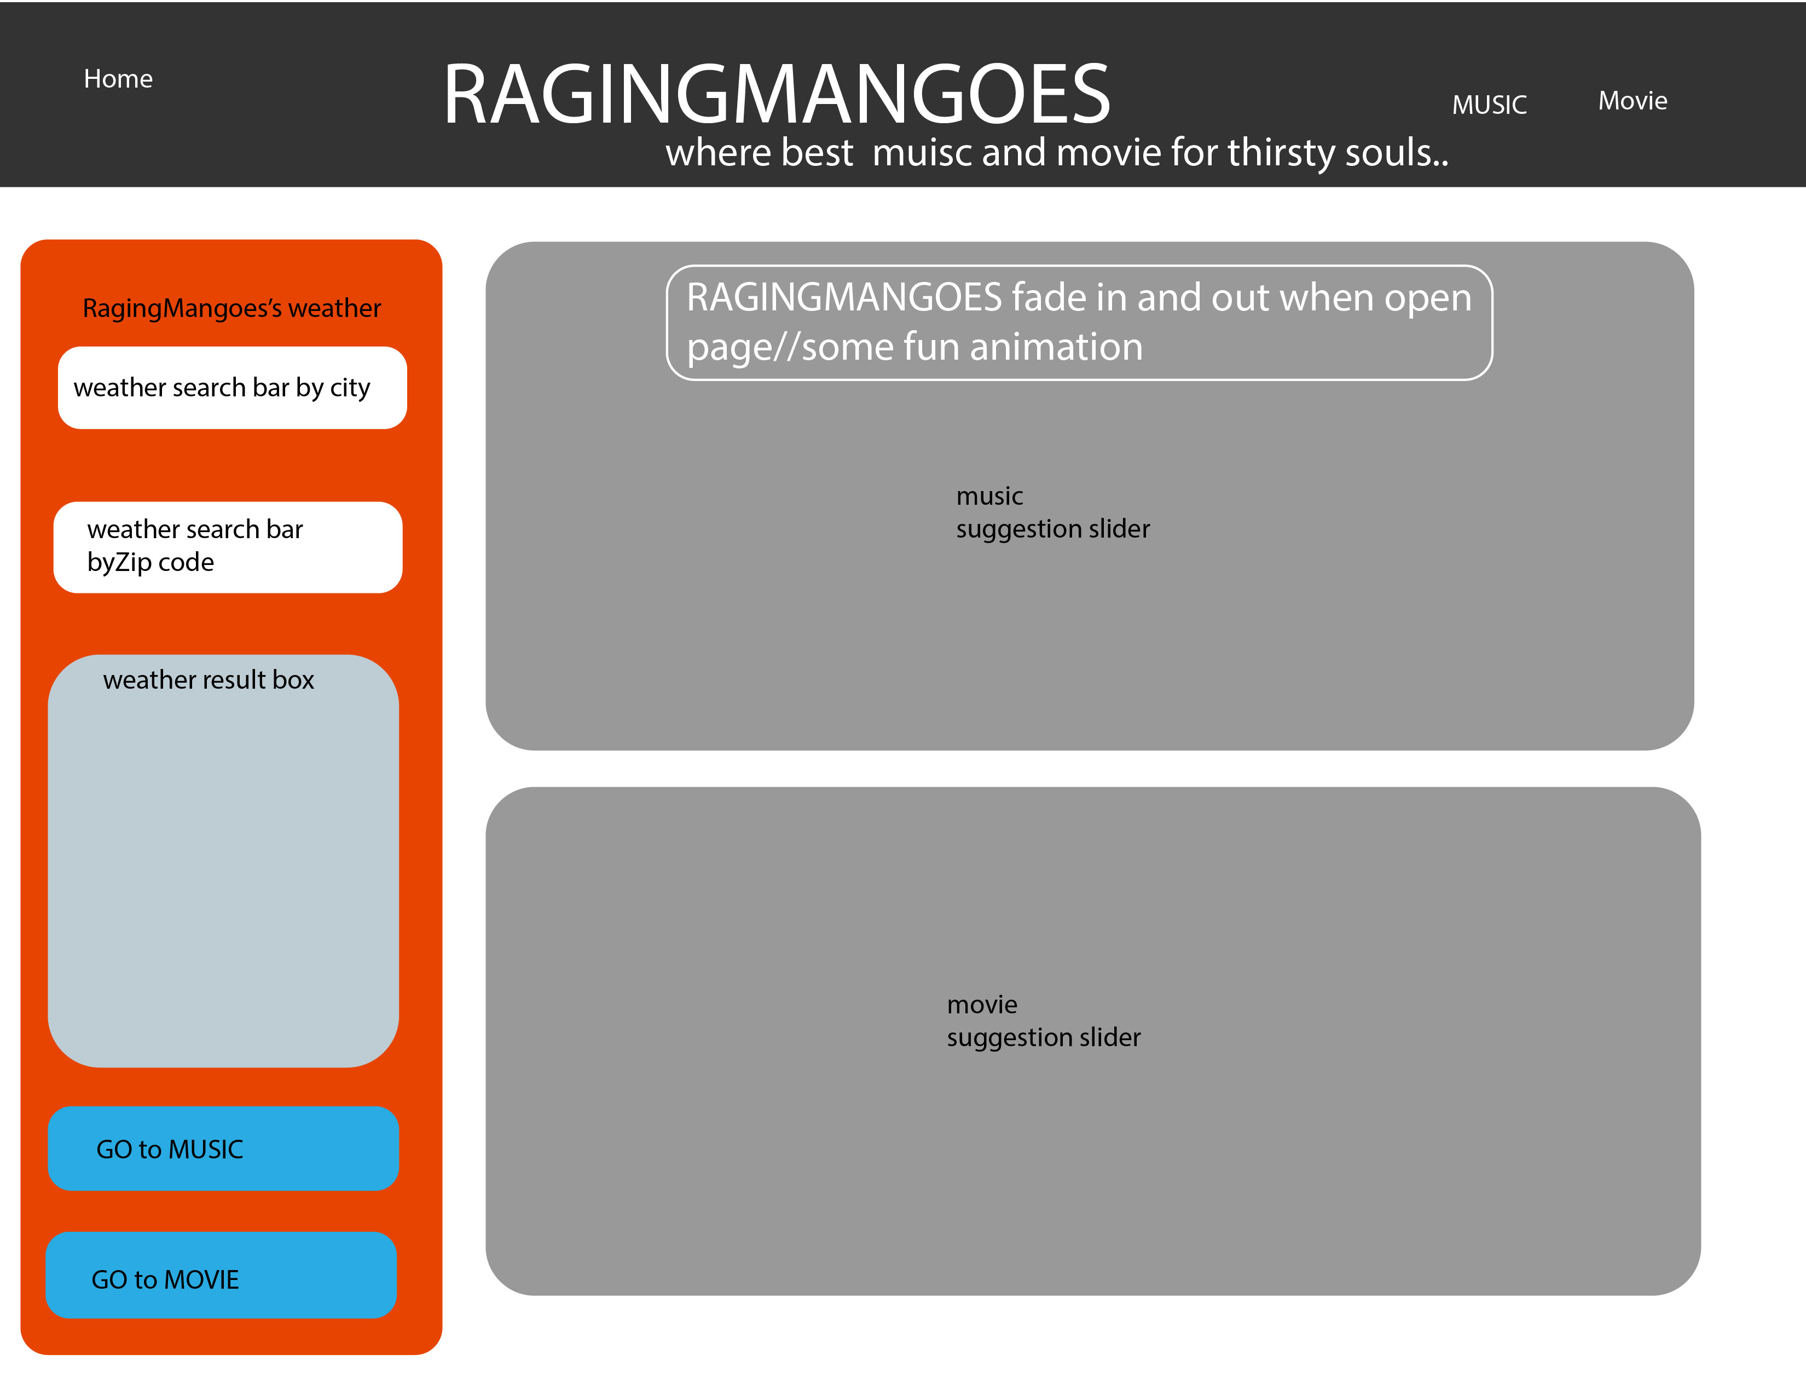
Original layout:

Slide 7
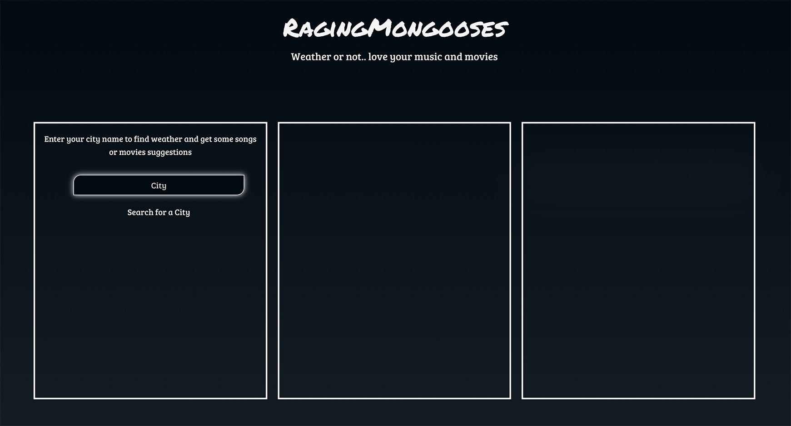
Actual APP view :
1. Layout
*Our brand-name:
Add animation effect
to give user fun view
* User
enter city data
Weather & selection
section
Movie/Music visualized
Info section
Video section
Where user can view
preview of mv and trailer

Slide 8
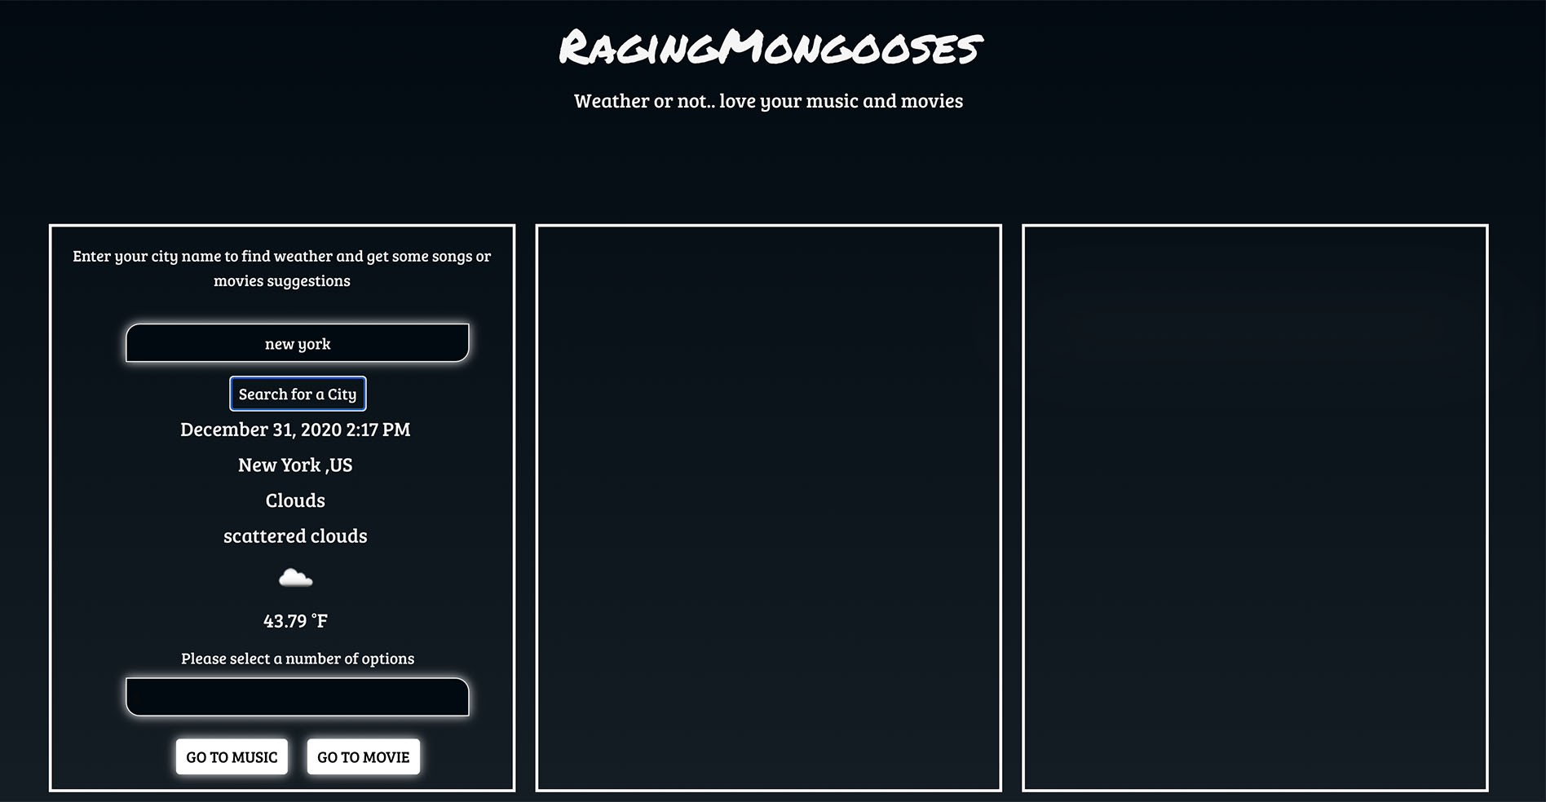
Actual APP view :
2. Weather info
/selection
User’s
Current time
Weather data
User’s
Number of selection
As dropdown menu

Slide 9
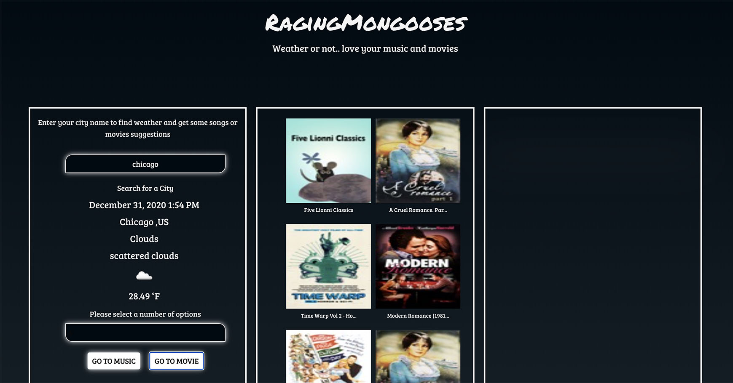
Actual APP view :
3. Visual info
User’s
Choice of Music /Movie
Visualized section
where user select before view
video

Slide 10
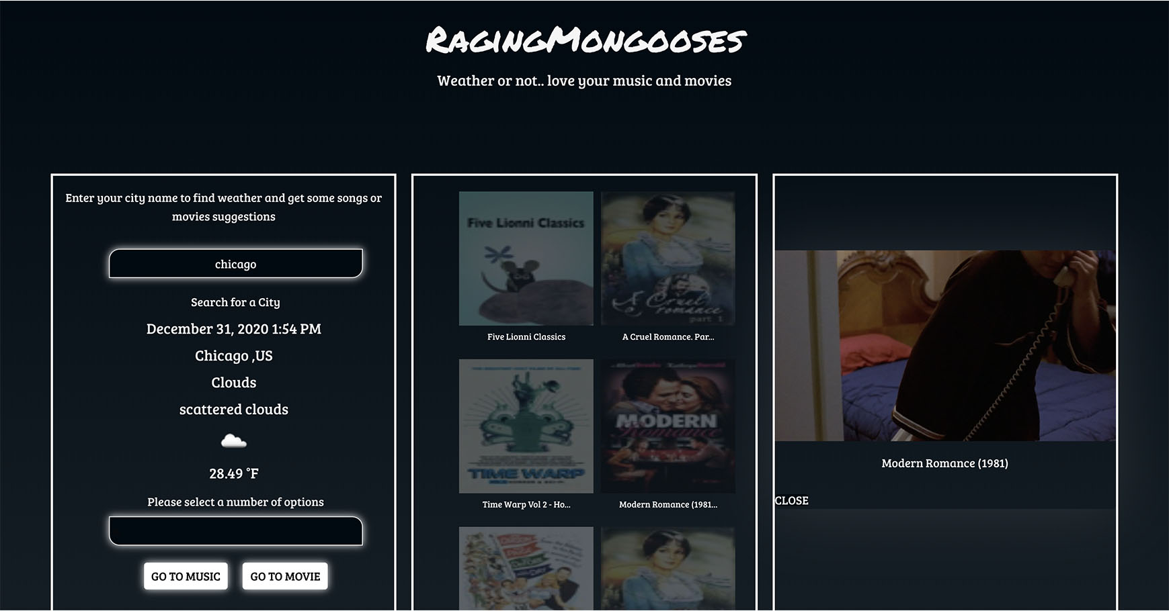
Actual APP view :
4.Video preview
Close button
to end video
Once video
playing image info section
gets blur

Slide 11
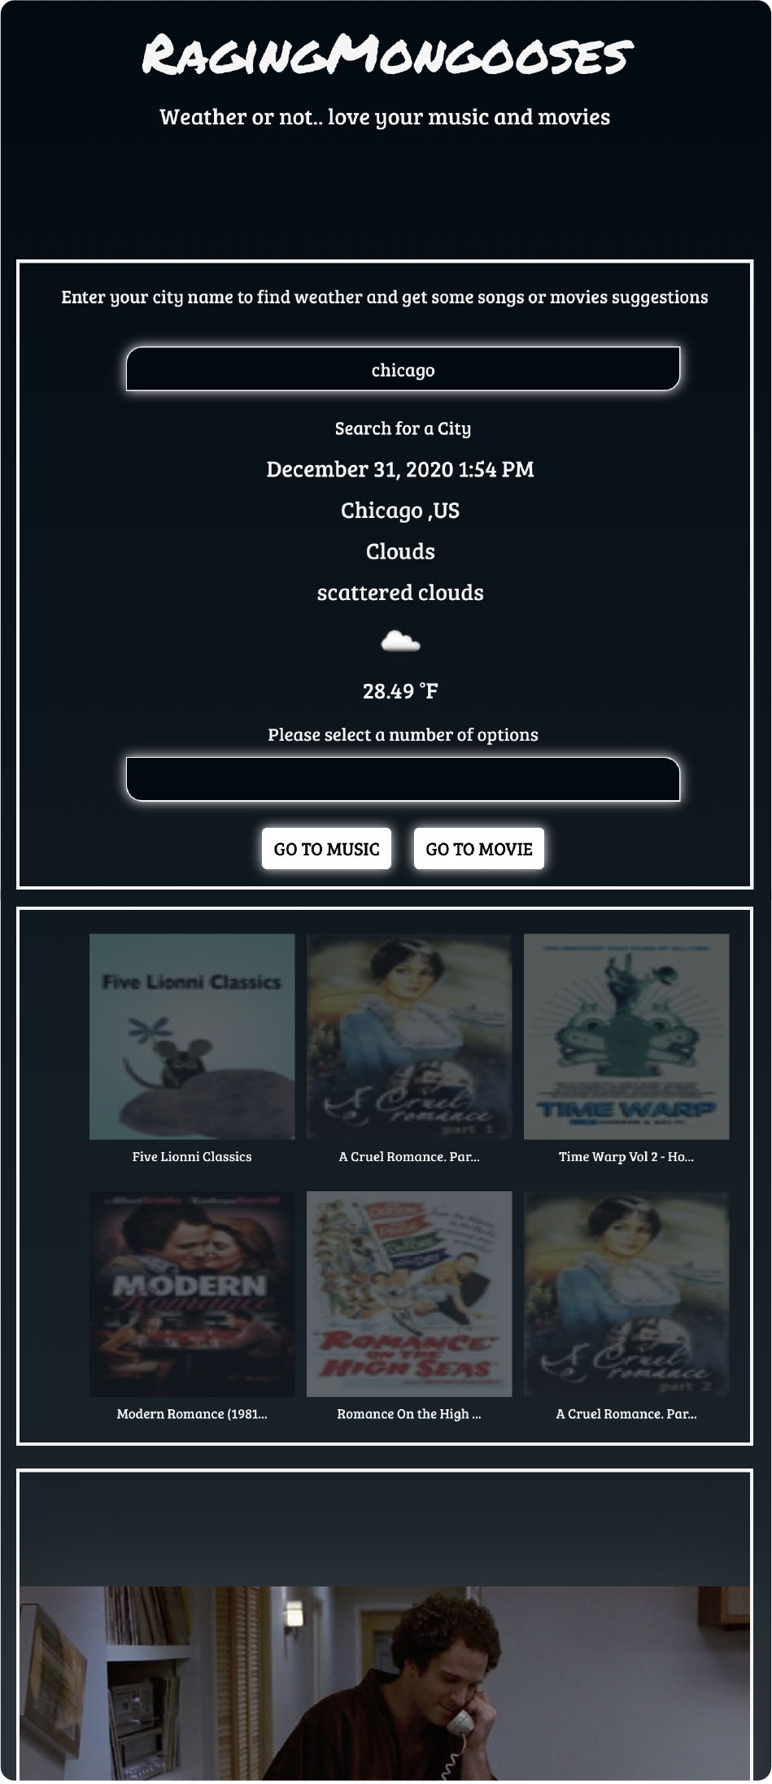
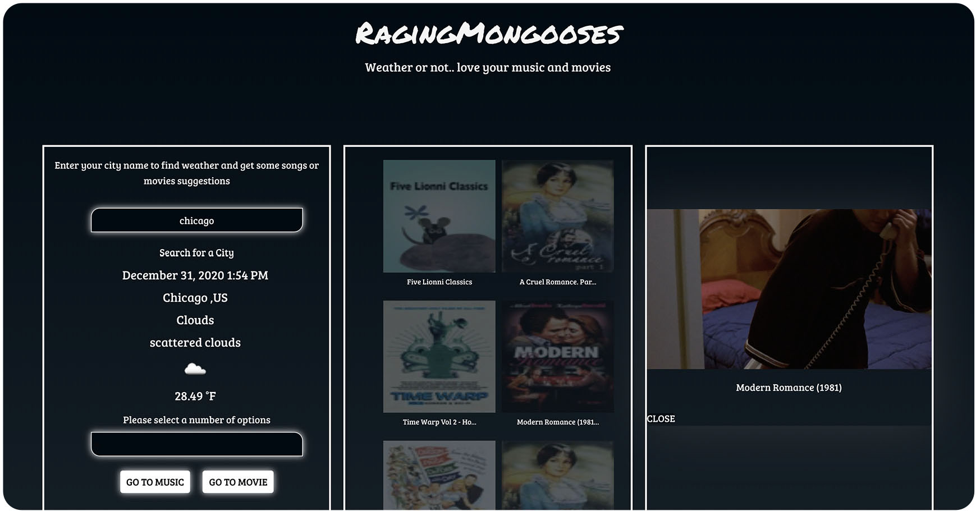
**Small screen APP**
Actual APP
view :
5.Responsive
view
**Full screen APP**

Slide 12
Check this out on
Git hub page : https://oliviapark113.github.io/project7_group-1/
From Group#1
Michael, Kristina, Paul & Olivia…xoxoxo

